Slide 1

Hands on with Hadoop
Session -2b: Hadoop Components & Tech Stack
Naren Thilla
Apr 28th 2015

Slide 2
The OS Analogy
Core Module
Keyboard/Input module
Storage/FS
Screen/output module
Compilers and Language Support
Schedulers
Additional Modules
Printer Support
Network Support
USB Support
GUI

Slide 3
Basic Hadoop Components
Storage – HDFS
Compute – Map Reduce/Spark
Scheduling – YARN
Database/SQL – Hive
Compiler/Languages
Scala, SQL (others- Java, R, Python)
Data Ingestion
Sqoop (others Talend…)

Slide 4

Simplified Framework for Understanding Hadoop 1.0 (Java)
Java (MR Program)
Map Reduce (Compute Engine)
Sources (DB, Twitter, FS)
HDFS (Storage)
Sqoop

Slide 5
Simplified Framework for Understanding Hadoop 1.0 + (SQL)
SQL Program (Beeline)
SQL
BI (Qlikview)
Hive Datastore
ODBC/JDBC
Map Reduce (Compute Engine)
Sources (DB, Twitter, FS)
HDFS (Storage)
Sqoop

Slide 6
A Framework for Understanding Hadoop 2.0 (Spark)
Spark API
BI (Qlikview)
ODBC/JDBC
Hive Data store
Spark (Compute Engine)
Sources (DB, Twitter, FS)
HDFS (Storage)
Sqoop

Slide 7
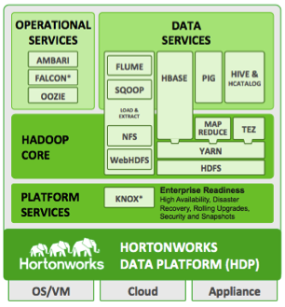
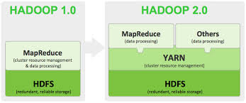
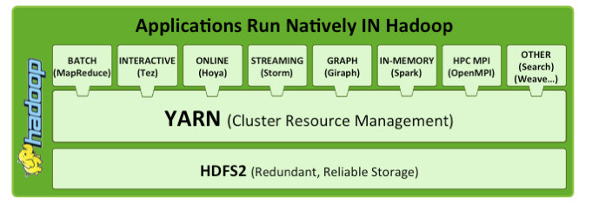
Hadoop 1.0 vs. 2.0

Slide 8
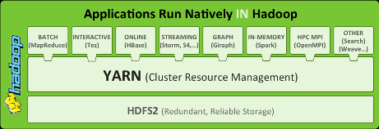
Hortonworks’ Stack

Slide 9
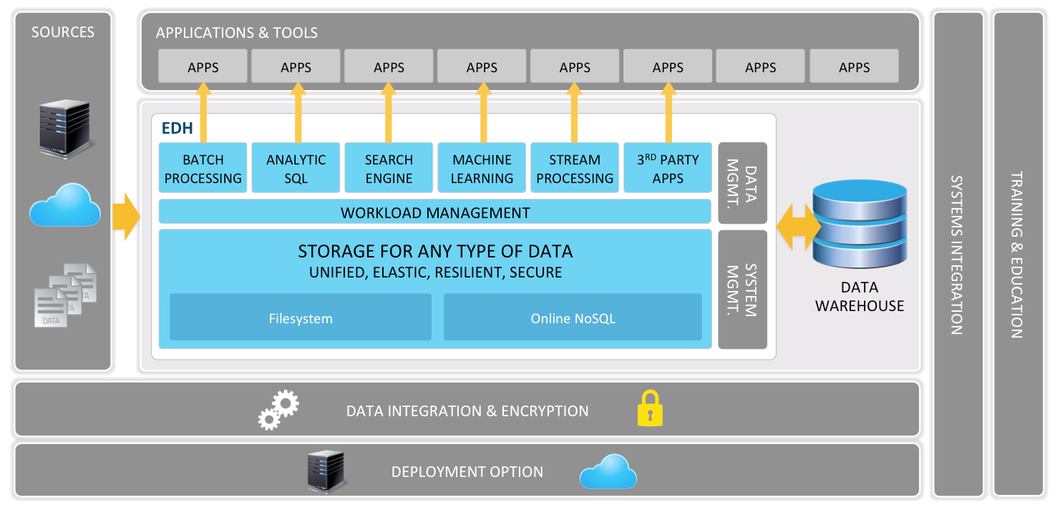
Cloudera’s Enterprise Data Hub (Unified Data Hub)

Slide 10
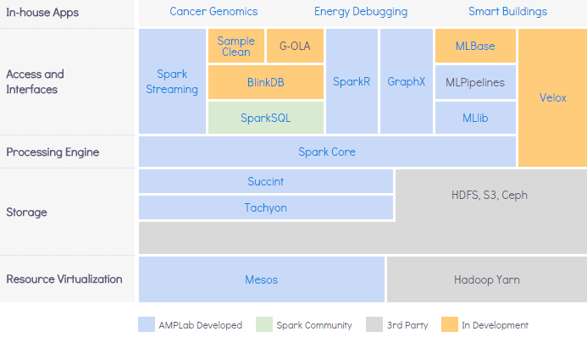
The AMPLab - BDAS stack

Slide 11
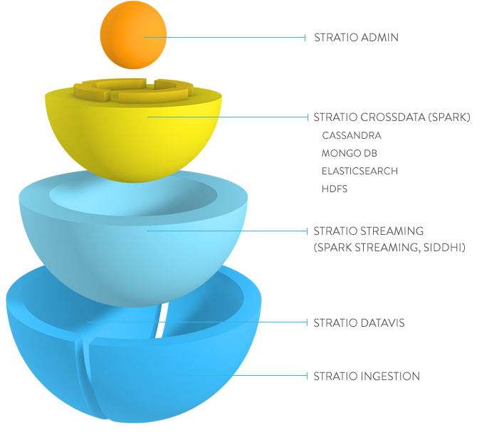
An Unified Data Hub (Stratio)

Slide 12
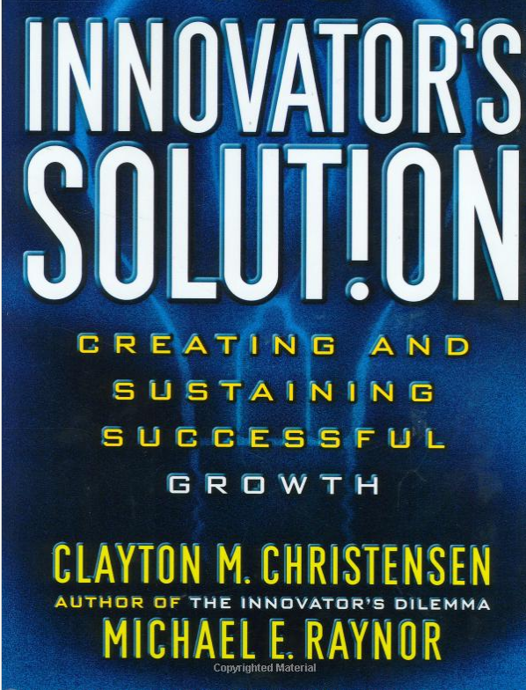
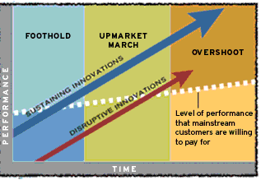
Which Stack to Use?

Slide 13

eDW vs. Hadoop
Granular Data Coarse (pre-computed)
Stage V eDW DataMart BI
Data Capture
Data Store
Data Analyze
Data View/Reports
Batch Processing (Large Storage Grid & Process Grid)
Throw away hi-fidelity data
Move Data to Analysis (ETL)
Note: Hadoop 101 for eDW Professionals
eDW 101 for Hadoop Professionals
Data Sources

Slide 14
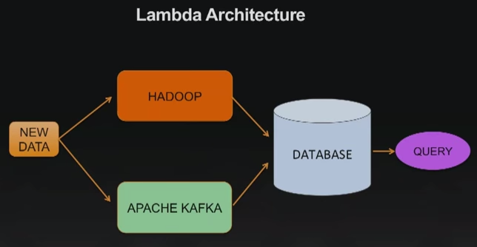
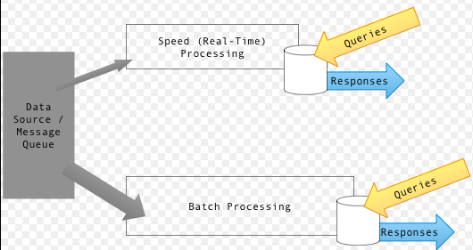
Lambda Architecture -
Source: Wikipedia https://en.wikipedia.org/wiki/Lambda_architecture

Slide 15
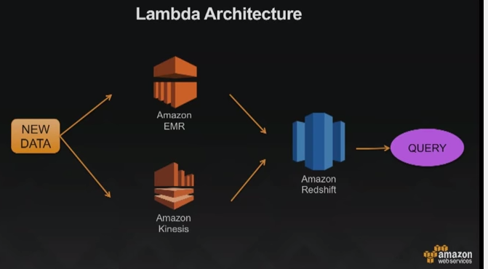
Beyond commodity Hardware

Slide 16
Hadoop – Stack (Possible Options)
HUMAN INTERACTION (GUI)
DATA ANALYTICS
Hue
Solr
Custom Code
Approx DB
Analytics (R)
Machine Learning
OPERATIONS
Custom Code
BI
RDBMS
Scheduling (Oozie, Control M)
COMPUTE GRID
Files (CSV, comment text etc)
Data Access Layer (Hive, Hbase, Impala)
Provisioning & Monitoring
(Ambari, Zookeeper)
Core Compute (Core Spark, MR)
Logs, Click streams
Data Operating System (YARN, Mesos)
STORAGE GRID - HDFS
Security
Social Data
RT
Real Time Data Ingestion – Streaming (Spark, KAFKA, Storm, Flume)
Mounted HDFS
Change Data Capture– Custom, Tungsten
Data Governance (Process & Policy)
NoSQL
Batch
Batch Data Ingestion (ETL) – Sqoop, Talend
Note: The Data Integration Layer is an indispensable layer for Enterprise Data Access. For brevity, the above stack is followed from a training point of view.

Slide 17

Hadoop – Stack (Possible Options)
HUMAN INTERACTION (GUI)
DATA ANALYTICS
Hue
Solr
Custom Code
Approx DB
Analytics (R)
Machine Learning
OPERATIONS
Custom Code
BI
RDBMS
Scheduling (Oozie,)
COMPUTE GRID
Files (CSV, comment text etc)
Data Access Layer (Hive)
Provisioning & Monitoring
(Ambari, Zookeeper)
Core Compute (Core Spark, MR)
Logs, Click streams
Data Operating System (YARN,)
STORAGE GRID - HDFS
Security
Social Data
RT
Real Time Data Ingestion – Streaming (Spark, KAFKA, Storm, Flume)
Mounted HDFS
Change Data Capture– Custom, Tungsten
Data Governance (Process & Policy)
NoSQL
Batch
Batch Data Ingestion (ETL) – Sqoop, Talend
Note: The Data Integration Layer is an indispensable layer for Enterprise Data Access. For brevity, the above stack is followed from a training point of view.

Slide 18
Take home & Assignments
Assignment 1: Do basic data ingestion into Hadoop and visualize the same
Use Random Generators and generate seed data:
https://www.mockaroo.com/
http://spawner.sourceforge.net/
Use genData script to create additional volume.
Use sqoop to move the data into Hive.
Connect Qlikview to create visualization
Assignment 2: Analyze Omniture Clickstream Data
http://hortonworks.com/hadoop-tutorial/how-to-visualize-website-clickstream-data/
Use Qlikview instead of Excel
Assignment 3:
Ingest initial and incremental data from MySQL into Hadoop (Hive) using Sqoop.
Visualize the same.
Assignment 4:
Extend NYSE example to include Map

Slide 19
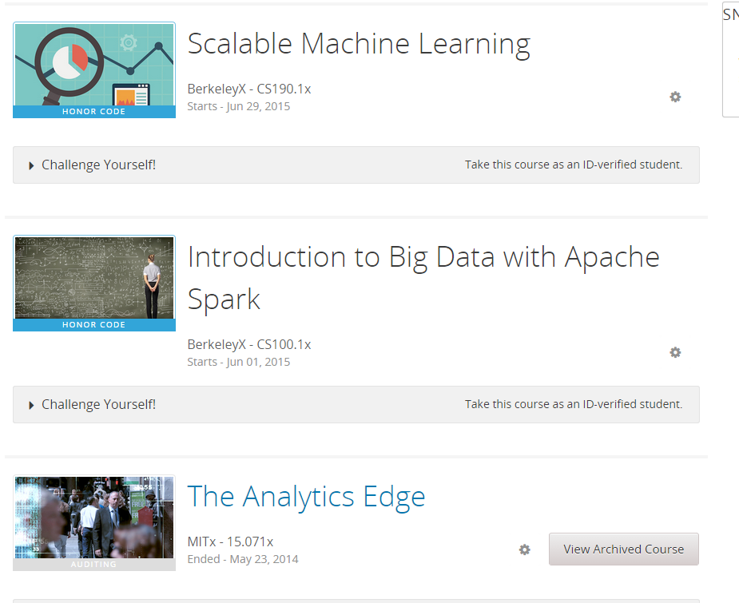
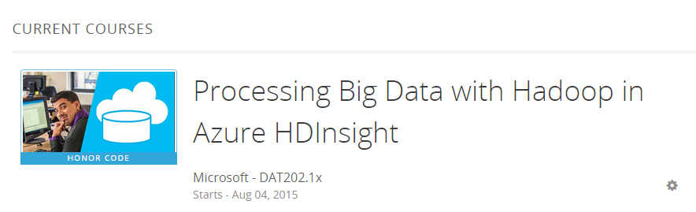
Public Courses (Edx)

Slide 20
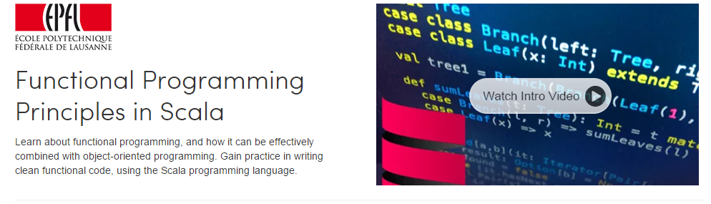

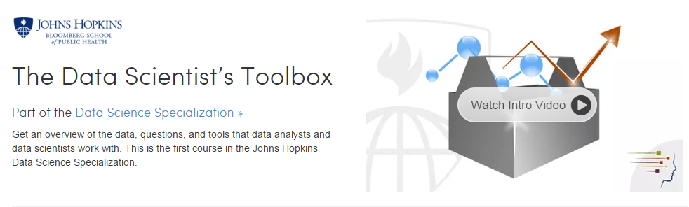
Public Courses (Coursera )

Slide 21
Hands on with Hadoop
Session -3: Big Data Projects
Naren Thilla
July 28th 2015

Slide 22
Infrastructure Layer - Big Data on the Cloud
1a
Objectives:
Explore the benefits of elastic storage over HDFS
Explore the benefits of elastic compute over dedicated computation layer.
Pros and Cons of Bidding for CPU
Compare Big Data PaaS offering with a native build-out IaaS
Tools:
IaaS – GC, AWS, HDInsight
PaaS – Qubole, Databricks
Outcome:
An white paper describing the benefits of Big Data on Cloud over traditional architectures.
Recommendation on PaaS or IaaS build out.
A sample implementation
Team

Slide 23
Infrastructure Layer – Encryption and Storage
1b
Objectives:
Explore innovations around file formats
Explore encryption techniques
Tools:
Avro, Parquet, Tachyon and others
Outcome:
An white paper describing the pros and cons of storage formats.
A Demo of various file formats and storage layers
Team

Slide 24
Real – Batch Data Ingestion Techniques
2a
Objectives:
Explore batch data ingestion using Sqoop, Talend etc
Scheduling data ingestion using Oozie and others
Ingesting structured, unstructured and semi-structured data
Create a metadata based ingestion layer that can move data from ANY source to ANY target (with features such as auditability etc)
Tools:
Sqoop, Talend, Oozie
Outcome:
Demo of an data ingestion pipeline
Team

Slide 25
Real – Time Data Ingestion Techniques
2b
Objectives:
Understand how to ingest Data from real-time sources such as Twitter, FB, Logs, CDC etc
Compare tools/frameworks such as Kinesis, Storm, KAFKA etc
Provide an architectural framework and sample code to push real-time into Hadoop eco-system.
Expected Outcomes:
Demo of real-time data ingestion into Hadoop ecosystem
Compare RT – Replication with RT Ingestion
Discussion on basic in-flight transformation
White paper on the choice of framework/architecture for RT Data
Tools:
KAFKA, Storm, Spark Streaming, Kinesis

Slide 26
Data Transformations in Big Data
3
Objectives:
Understand how to do data modeling on Big Data
Understand the need for Integration Layer
Recommend the data layer tools and architecture
Outcomes:
Whitepaper on Data Modeling on Big Data
Recommend tools for Data Layer (Hive, HBase etc)
Key Tools:
Data Modeling (TBD)
Data Layer (Hive, Hbase, Spark SQL, Cassandra etc)
Team:

Slide 27
Business Intelligence on Big Data
4
Objectives:
Provide exploratory analysis of BI tools on Hadoop ecosystem.
Compare how traditional BI tools (MSTR, Tableau) compare with Next Gen Big Data BI tools such as ZoomData and Platfora.
Key Tools For Assessment
Traditional BI Tools – (One of) MSTR, Qlikview, Tableau (Connectivity through ODBC/JDBC)
Next Gen Tools – (One of) Platfora, Zoom Data
Connecting to Spark Cluster via Spark ODBC
Custom Coding for D3 Visualization using Lightning and/or Spark Notebooks.
Expected Outcome:
Demo of traditional BI tools on a Big Data ecosystem
Demo of Next Gen BI tools on a Big Data ecosystem
Demo of native build out using D3/Lightning or other Scripting technologies.
White paper on Pros and Cons of Next Gen BI tools vs. Traditional BI tools vs. native build out
Team:

Slide 28
Optimization & Performance Tuning
5
Objectives:
Infra setup
Identification of data sets
Benchmarking query performance on :
Hive on MR vs Hive on Spark vs. Spark SQL
Benchmarking storage performance :
Row vs. Columnar storage
Compression and Performance
Parquet, AVRO, Tachyon etc
Recommending Caching solutions such as Out of Heap Cache, JVM cache etc
Other tuning techniques (such as map-side joins, indexing, partitioning etc)

Slide 29
Putting it together : Next Gen Data Pipeline
6
Objectives:
Build a next-gen framework that takes data from one or more sources, cleanses, transforms and finally helps in visualizing the same.
The fr
Sample data set can be:
ARLT data set
Enterprise Data mart for Web logs
Tools:
Hadoop cluster on GC or AWS, Azure etc
Modeling Tool (anything available)?
Spark SQL or Hive
Any visualization Tool

